Slide 1
Hospital-Acquired Infections in new york state
ANALYSIS AND SUMMARY

Slide 2

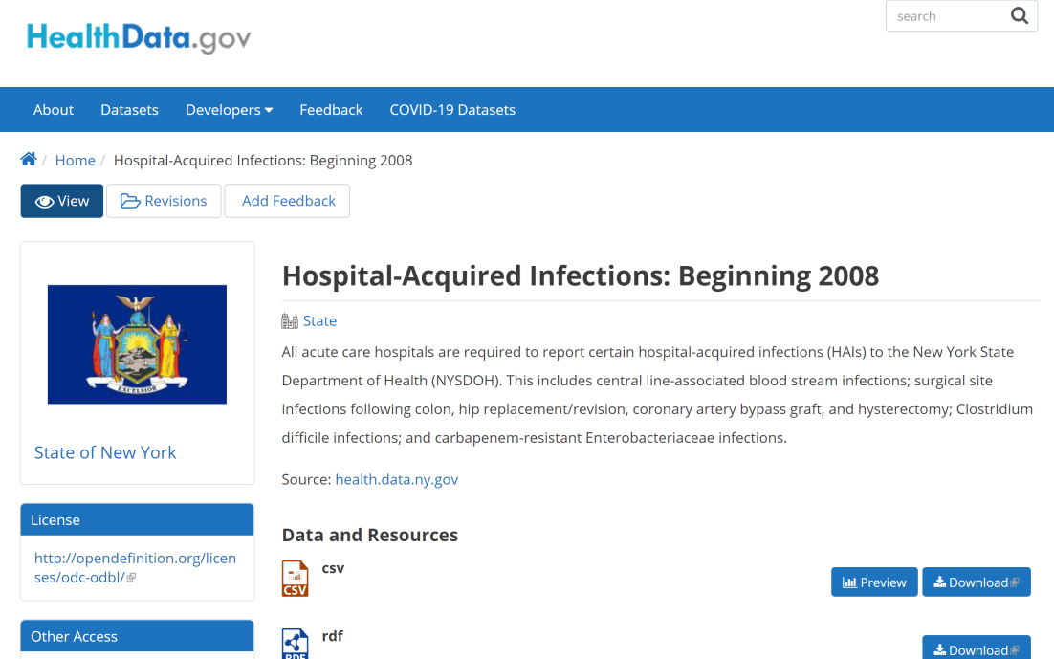
Data sources
https://healthdata.gov/dataset/hospital-acquired-infections-beginning-2008
https://healthdata.gov/dataset/hospital-acquired-infections-beginning-2008
Notes:
This analysis uses a publicly-available dataset provided by New York State Department of Health. This data contains information on the number of hospital-acquired infections observed at individual NY facilities between 2008 and 2018. Types of infections tracked include:
CDI - Clostridium difficile infections
CLABSI - central line-associated blood stream infections
SSI - surgical site infections following colon, hip replacement/revision, coronary artery bypass graft, and hysterectomy
CRE - carbapenem-resistant Enterobacteriaceae infections

Slide 3
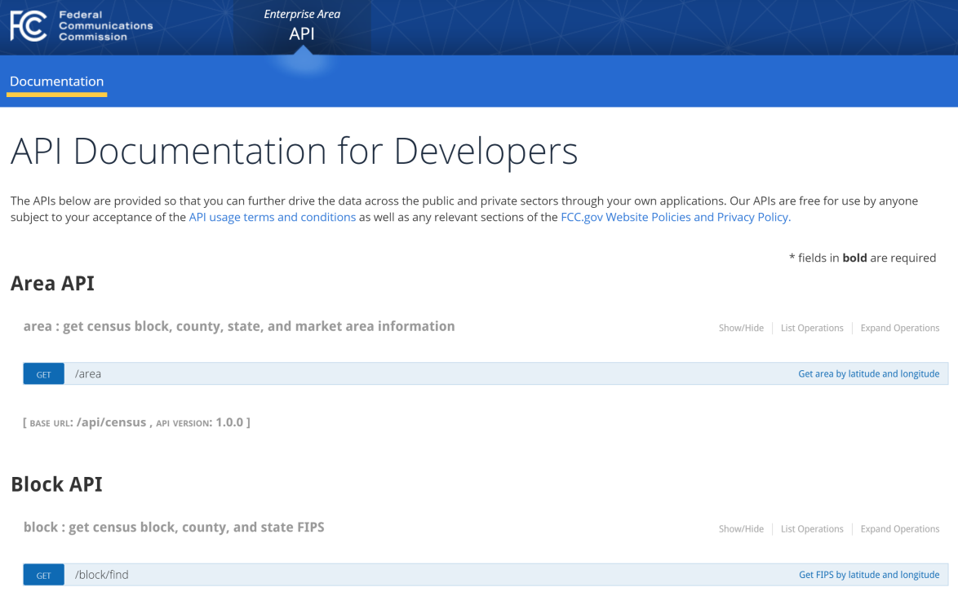
Data sources
https://healthdata.gov/dataset/hospital-acquired-infections-beginning-2008
https://geo.fcc.gov/api/census/
Notes:
The FCC’s Census Block API was used to provide additional geographic information about the county where each reporting facility is located. This is a free API.

Slide 4
Data INCLUDED
Facility ID
Hospital Name
Geographic Location (Latitude, Longitude, County Name, County FIPS)
Year
Indicator Name
Infections Observed (total count)
Infections Predicted
Indicator Units
Indicator Value (calculated based on total count and units)
Notes:
The Indicator Units vary depending on the type of infection tracked. For example, surgical site infections (SSI) are measured as the number of infections observed per 100 procedures, but central line-associated blood stream infections (CLABSI) are measured per 1000 line days.

Slide 5
Data INCLUDED
API: County Name, County FIPS
Facility ID
Hospital Name
Geographic Location (Latitude, Longitude)
Year
Indicator Name
Infections Observed (total count)
Infections Predicted
Indicator Units
Indicator Value (calculated based on total count and units)
Indicator Code Indicator Area
SSI Hysterectomy
CDI Hospital Onset
CLABSI Pediatric ICU
Standardized Infection Ratio (SIR)
Notes:
To facilitate deeper analysis, the Indicator Name values have been split into two elements: the “code” and the “area”. The code is an abbreviation for the type of infection. The area provides a sub-category for tracking those infections. For example, the Indicator Name “SSI Hysterectomy”, used to report surgical site infections after hysterectomy procedures, is broken down into the code “SSI” and the area “Hysterectomy”.
The standardized infection ratio (SIR) was also calculated by dividing the number of infections observed by the number infections predicted. These predictions are provided by New York State and take into account risks from the community each facility typically serves as well as the complexity of procedures performed there. As a result, the SIR provides a better measurement of individual hospital performance than the total number of infections or the indicator value.

Slide 6
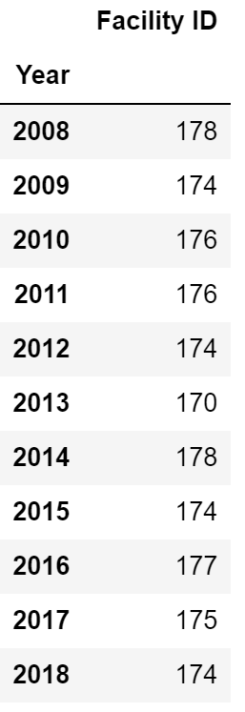
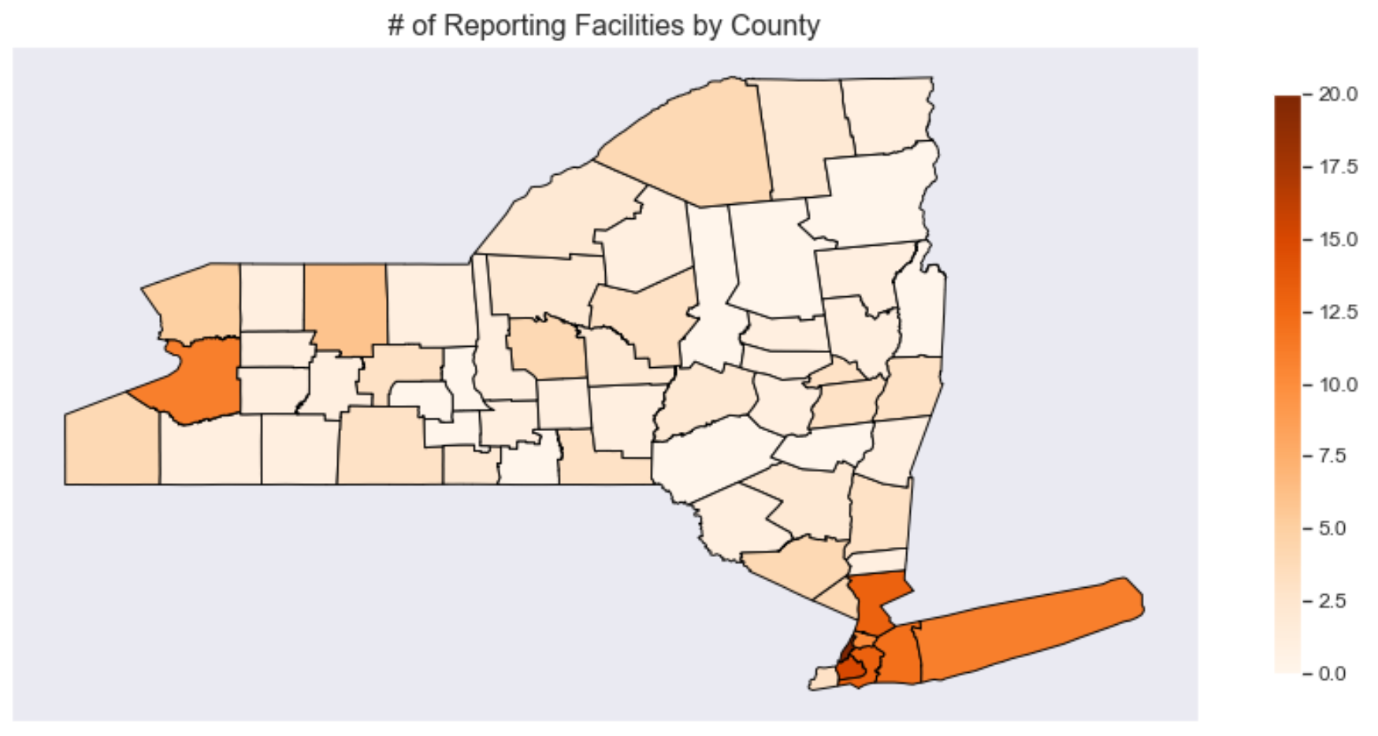
FACILITY DISTRIBUTION
How many facilities reported each year?
How are they distributed around the state?
Notes:
Most of the facilities are near the NYC metropolitan area in the southeast corner of the state. Erie county, on the western edge of the state, also has quite a few facilities. Other counties generally appear to have fewer than 8 reporting facilities each.

Slide 7
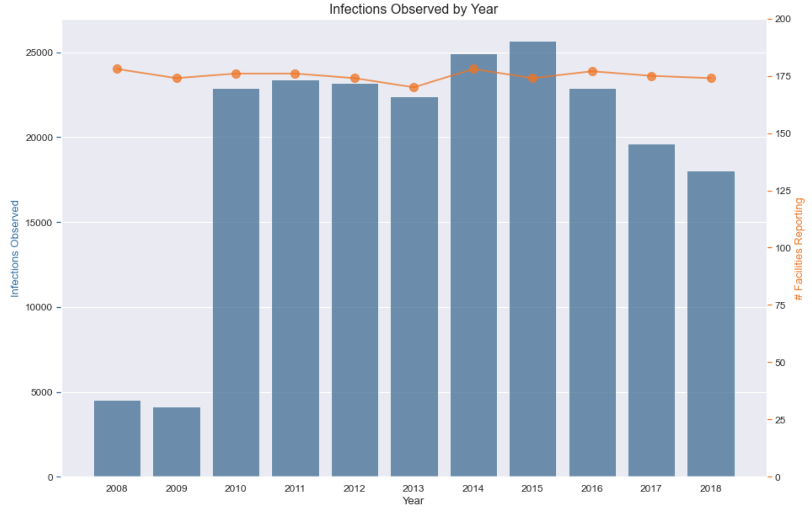
Large-scale trends
How has the number of observed infections changed over the past 11 years?
Notes:
Looking at the total infections observed (blue bars) for all indicators and all years in the data reveals a large increase between 2009 and 2010. However, the number of facilities reporting (orange line) appears to stay roughly the same.

Slide 8
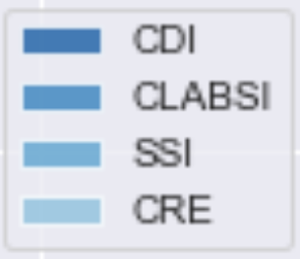
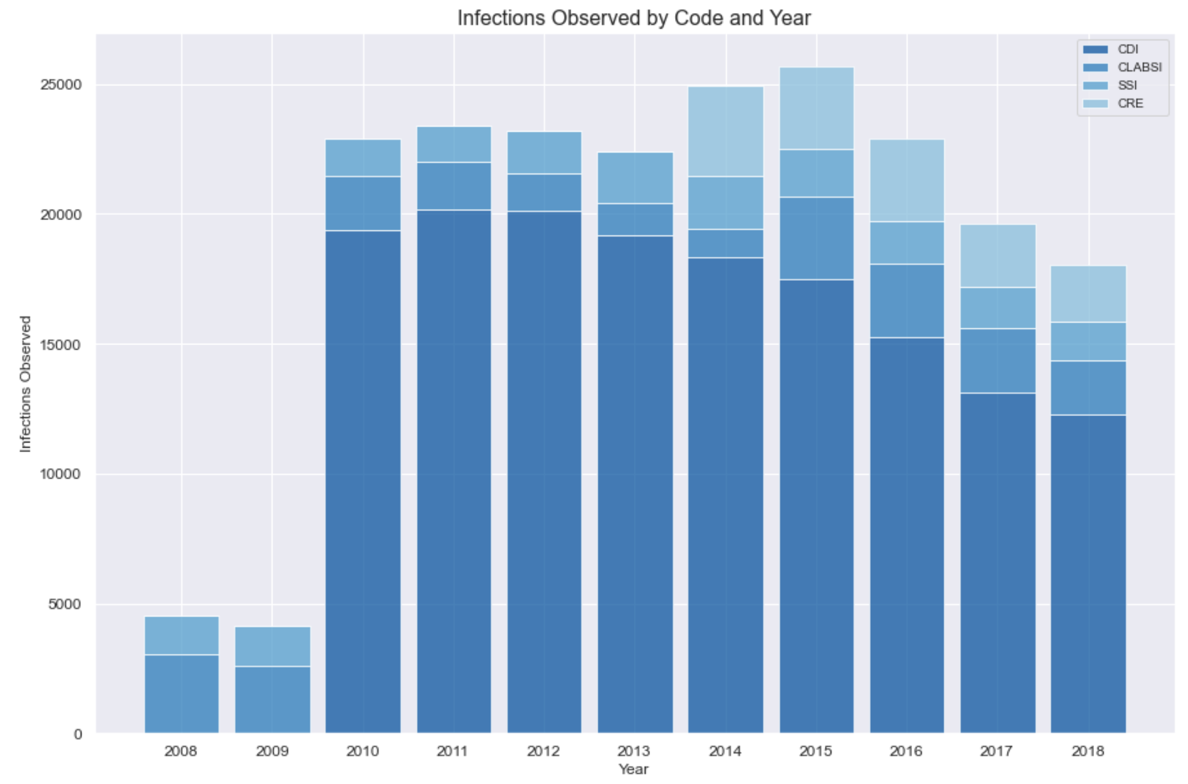
Large-scale trends
Why was there such a big jump in 2010?
CDI: Clostridium difficile infections
CLABSI: central line-associated blood stream infections
SSI: surgical site infections following colon, hip replacement/revision, coronary artery bypass graft, and hysterectomy
CRE: carbapenem-resistant Enterobacteriaceae infections
Notes:
By breaking down each bar into the indicator codes reported, it’s apparent that CDI were first reported in 2010. Since CDI are by far the most commonly observed infection in NY facilities, this addition in the middle of the date range skews this chart to appear as if there is a large increase. There is another (smaller) bump in 2014 when CRE were first reported.
Starting in 2015, the overall infections observed appear to be trending downward each year.

Slide 9
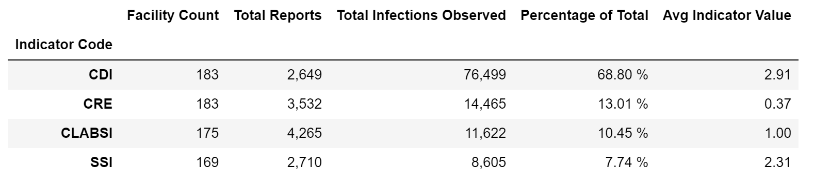
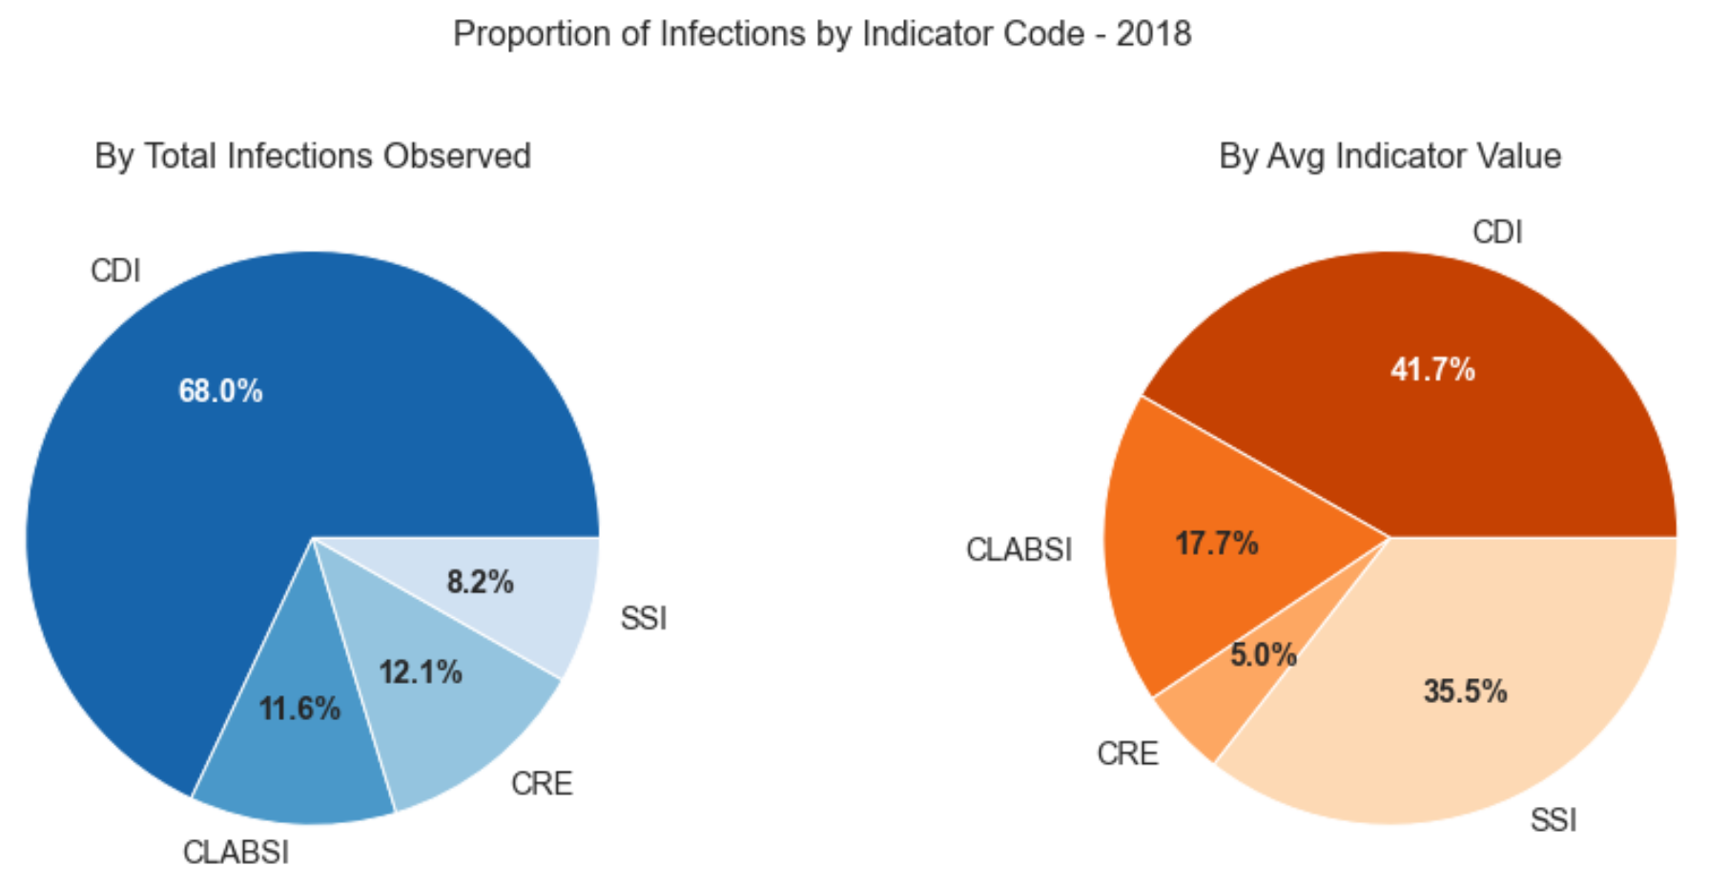
Infections by type
How do infection totals and incidence rates compare across the four indicator codes reported by NY facilities?
2014-2018
Notes:
The table summarizes the infection totals for each of the indicator codes available in the dataset over the years 2014-2018 (the only years when all four indicator codes were reported).
The pie charts cover only the most recent year (2018) to determine whether the proportions of infections remained consistent with the overall trend for 2014-2018, and they do seem to be.
The blue pie chart looks at the proportions for the number of total infections observed.
The orange pie chart compares the average indicator values. As previously mentioned, the indicator values in the dataset are adjusted so they report the number of infections per a determined number of processes (e.g., SSI indicator values measure the number of observed infections per 100 surgical procedures). Therefore, this metric provides a better measure of the infection incidence than the raw count.
An interesting observation in both the table and the pie charts was that while the number of SSI infections observed was the least of the indicator codes, its indicator value was disproportionately high.

Slide 10
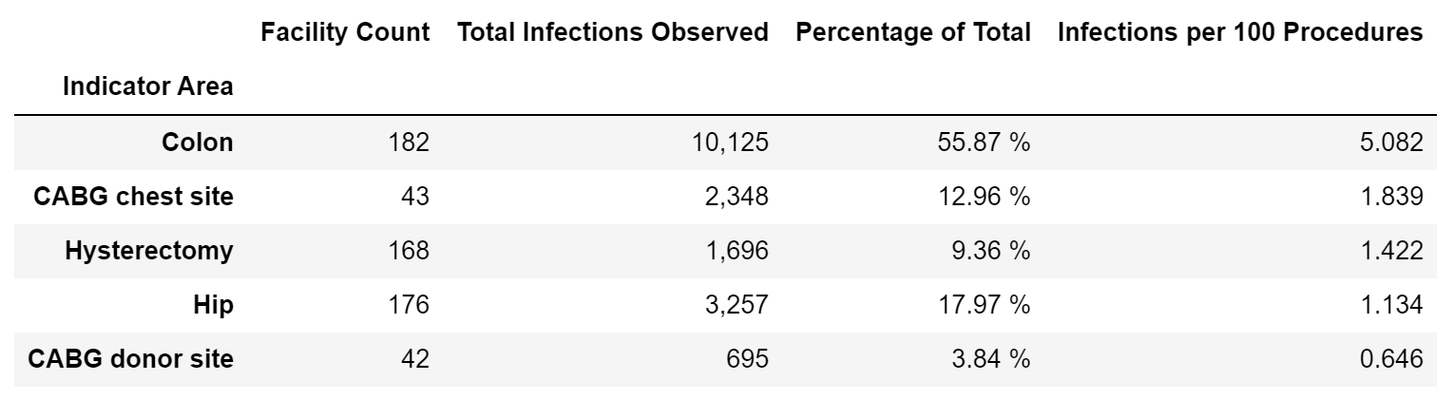
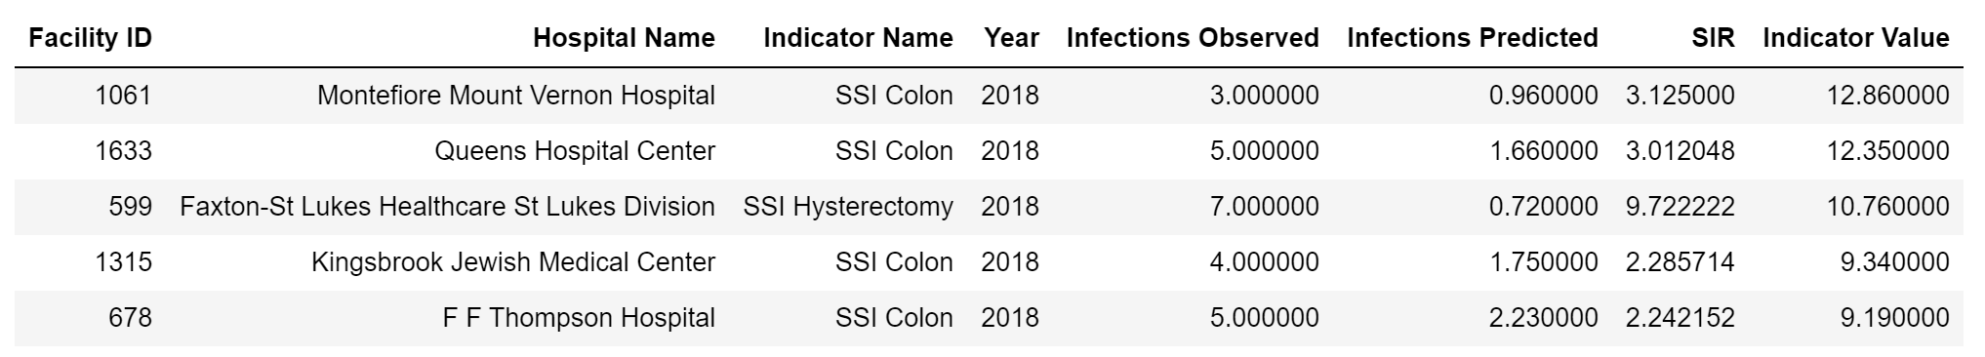
Surgical site infections
Which surgical procedures resulted in the highest infection rates from 2008-2018?
Which facilities had the highest SSI indicator values in 2018?
Notes:
SSI are most commonly experienced after colon procedures, regardless of whether this is measured by total infections observed or by the number of infections per 100 procedures.
Four of the top five highest indicator values for individual facilities were also related to colon procedures.
The next slide will explore how these indicator values vary across facilities to determine whether all hospitals are performing roughly the same on these measures (within each code), or if there is a lot of variability.

Slide 11
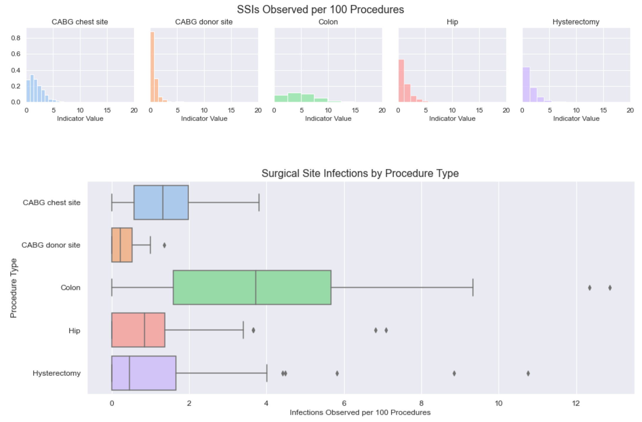
Surgical site infections
How do SSI indicator values vary across NY facilities for different surgical procedures?
Notes:
These histograms and box plots provide two different views comparing the distribution of SSI indicator values across the various facilities from 2008-2018. The histograms at the top provide a front-facing view of the distribution. The box plots provide a similar view, but from above (diamonds indicate outliers).
Its clear that the shape of the Colon distribution is quite different than most of the other procedure types.
The “best” distribution looks like the CABG donor site (orange), where the vast majority of facilities (>80%) have very low indicator values, and the bars taper off quickly, indicating minimal variability across facilities. In contrast, the colon histogram is quite flat, and the whiskers on the box plot extend much further than the other procedure types. This shows that SSI from colon procedures are both higher on average than for other procedure types and vary widely across facilities.

Slide 12
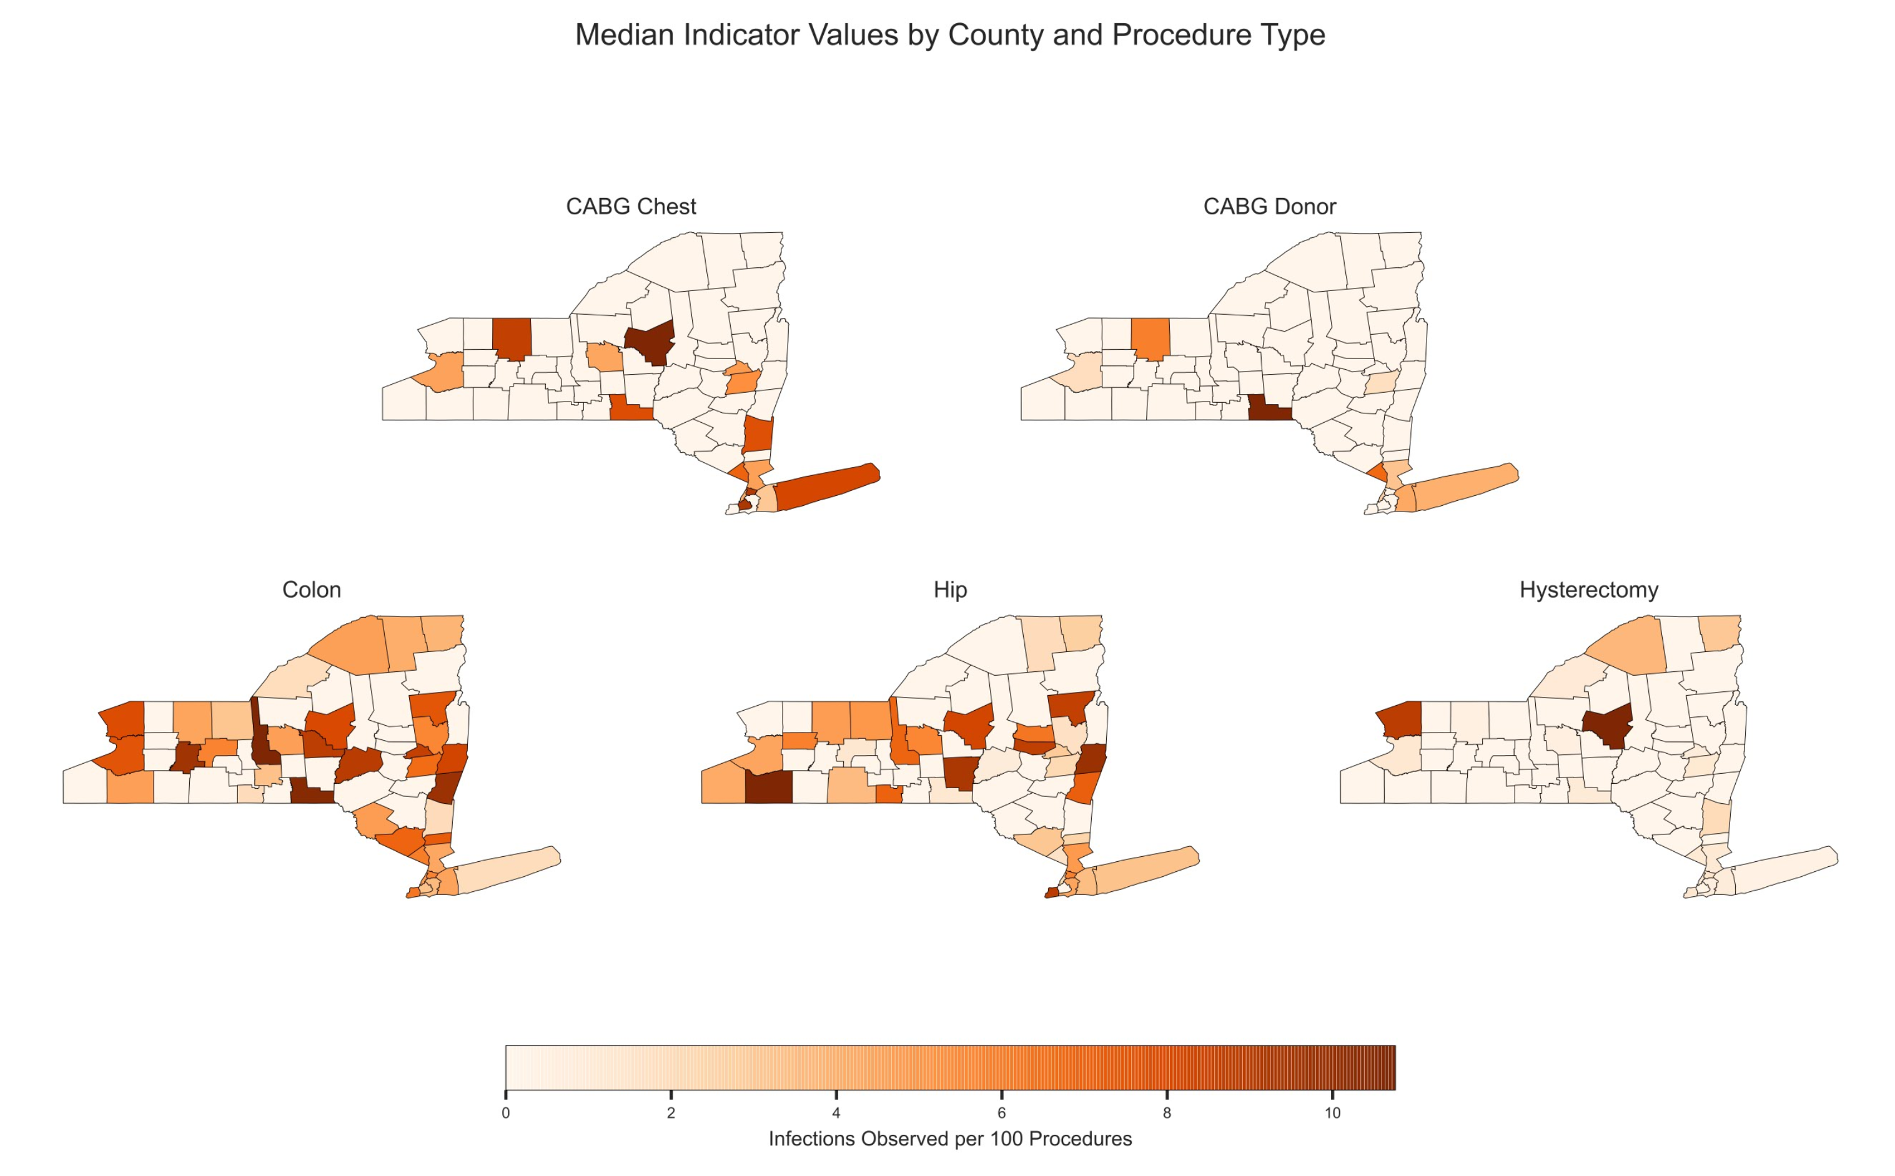
Surgical site infections
How do SSI indicator values vary geographically?
Are issues widespread or localized to a few counties?
Notes:
Looking at the median indicator values by county, it seems SSI following colon procedures are relatively high across the state. Hip procedures also appear to have widespread issues, whereas CABG and hysterectomy issues seem more localized.

Slide 13
Key takeaway
Opportunity for Improvement
Because there is a high degree of variability in SSI indicator values for colon procedures across NY facilities, this may be an optimization opportunity.
If the best performing hospitals are studied to determine how they avoid SSI after colon procedures, perhaps more standardized processes or better tools can be developed and implemented at other hospitals to reduce SSI state-wide.

Slide 14
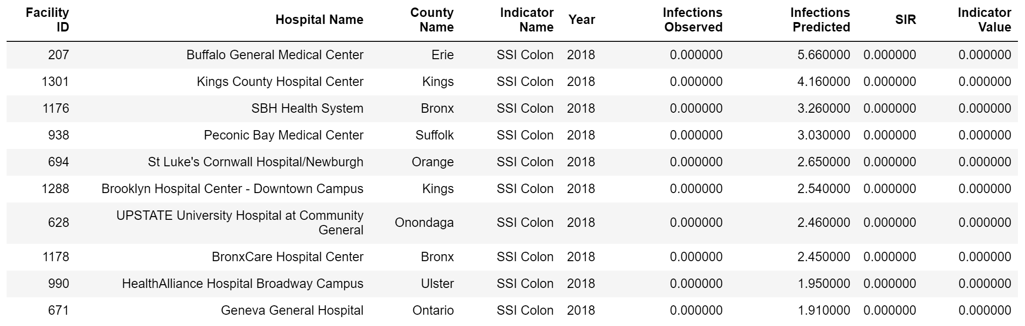
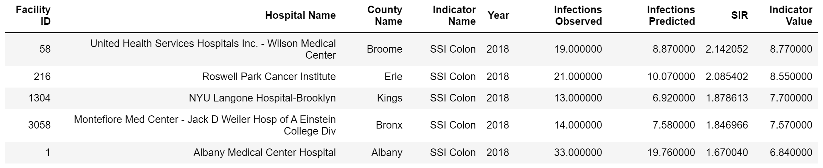
Key takeaway
Which 10 hospitals should I study to develop better processes or tools?
(Top 10 hospitals with the lowest SSI Colon SIR values for 2018)
Which 5 hospitals should I prioritize for optimization efforts?
(Top 5 hospitals significantly above the NY average SSI Colon indicator value for 2018)

Slide 15
summary
About 175 hospital facilities in NY reported annually on the number of hospital-acquired infections observed within their facility between 2008 and 2018. The majority of these facilities are very near to or within the New York City metropolitan area.
Clostridium difficile infections (CDI) account for almost 70% of observed infections. Despite having a much smaller number of total infections, surgical site infections (SSI) have a relatively high incidence per 100 procedures.
There is a large variance in the incidence of SSI for Colon procedures across NY facilities. There may be opportunities here to study facilities with low SSI Colon incidences and develop standardized processes and tools to limit variability. Facilities with high SSI Colon incidences can be prioritized for implementation of these processes.

Slide 16
Resources
RESOURCES
GitHub Repository
NY_Hospital_Acquired_Infections_2008-2018.ipynb
Datasets:
Hospital-Acquired_Infections__Beginning_2008.csv
NY_geo.csv (built from API data and exported to csv)
HAI_Data.csv (final dataset for analysis)
Python libraries used:
For data analysis: numpy, pandas, pprint
For visualization: matplotlib, seaborn
For API calls: requests, urllib, time
For mapping: os, shapefile, geopandas, shapely, citipy
For shapefiles: us

